Slide 1

A mini project on
Wine Quality Prediction
Name: Gudi Varaprasad
Reg. no: 19BCE7048
Guided by : Prof. Srinivasa Rao Battula sir

Slide 2

Link to the dataset
ABOUT DATASET
Objective :
The dataset contains different chemical information about wine. It has 1600 instances with 12 variables. The dataset is beginner friendly for classification and regression tasks. The model can be used to predict wine quality.
Features :
Two types of variables are there in the dataset, i.e., input and output variables.
Input variables are fixed acidity, volatile acidity, citric acid, residual sugar, and so forth.
The output variable is quality.
12 attributes are present and the attribute characteristics are real.
The number of total records is 1600.

Slide 3
Link to the dataset
ABOUT DATASET
Information about input variables based on physicochemical tests:
1 – Fixed acidity 2 – Volatile acidity 3 – Citric acid
4 – Residual sugar 5 – Chlorides 6 – Free sulfur dioxide
7 – Total sulfur dioxide 8 – Density 9 – pH 10 – Sulphates
11 – Alcohol
Output variable (based on sensory data): 12 – Quality (score between 0 and 10)

Slide 4

ALGORITHMS ANALYZED
Decision Tree
Random Forest
Logistic Regression
K-Nearest Neighbors
Support Vector Machine

Slide 5
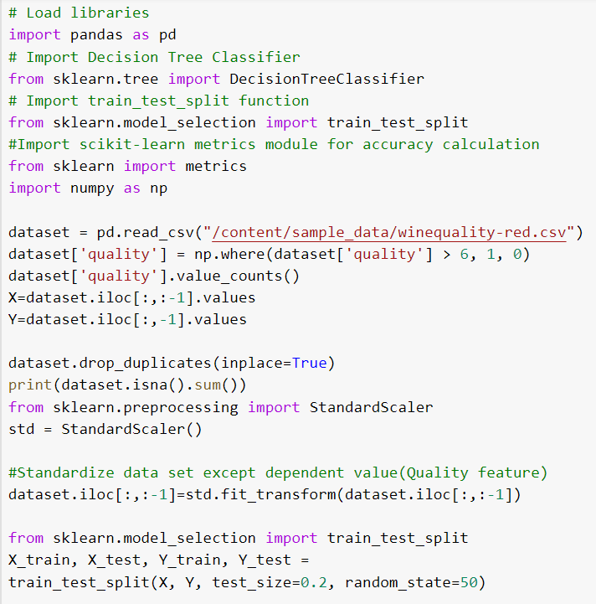
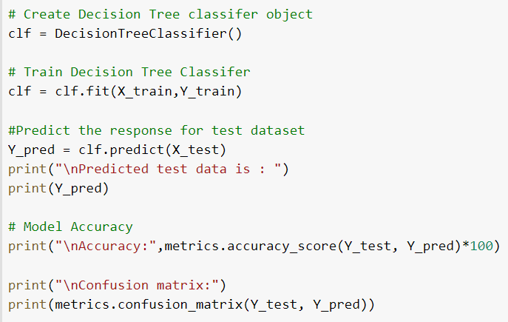
DECISION TREE - Code

Slide 6
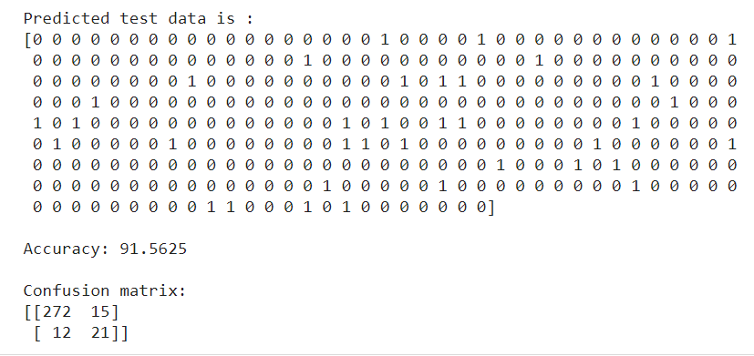
DECISION TREE - Output

Slide 7
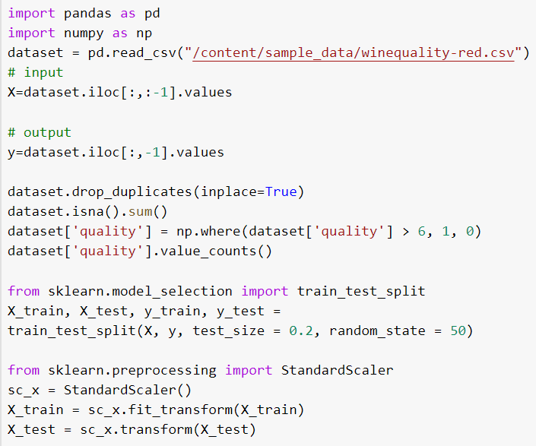
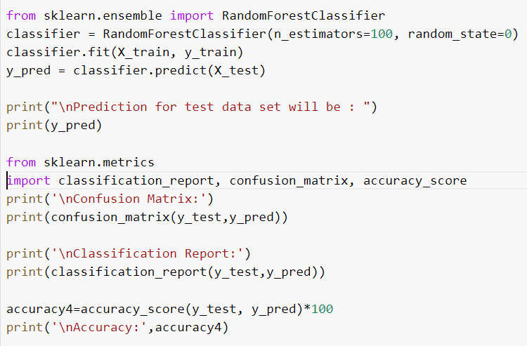
RANDOM FOREST - Code

Slide 8
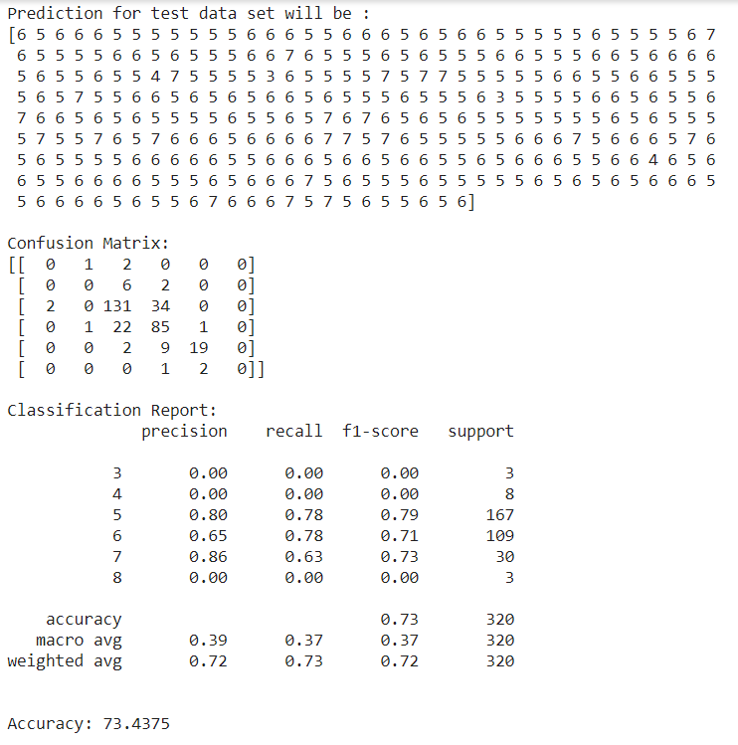
RANDOM FOREST - Output

Slide 9
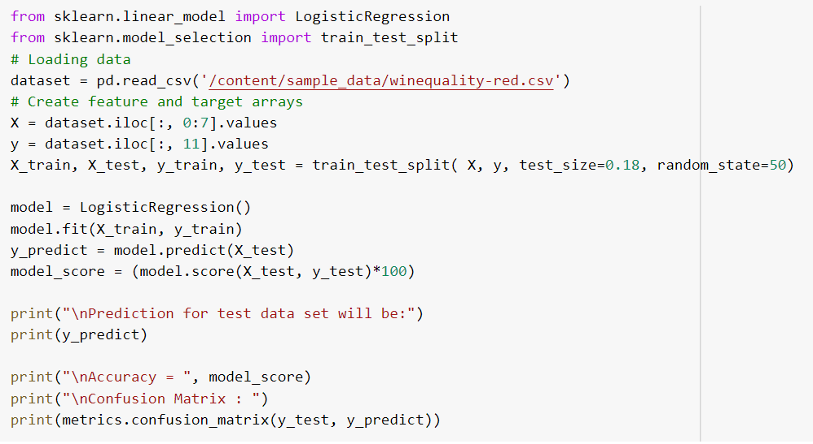
LOGISTIC REGRESSION - Code

Slide 10
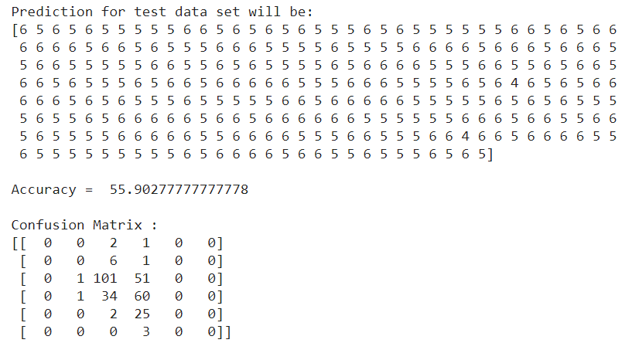
LOGISTIC REGRESSION - Output

Slide 11
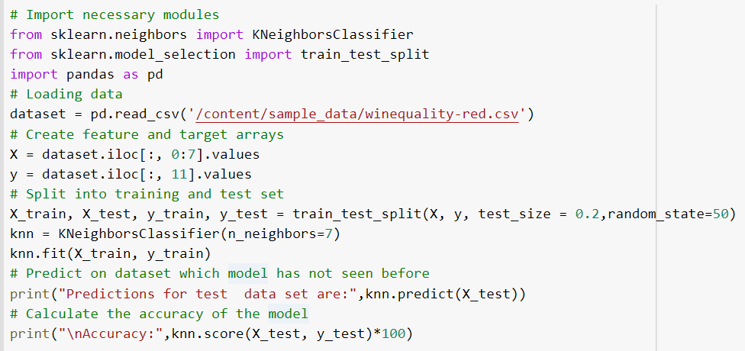
K-NEAREST NEIGHBORS - Code

Slide 12
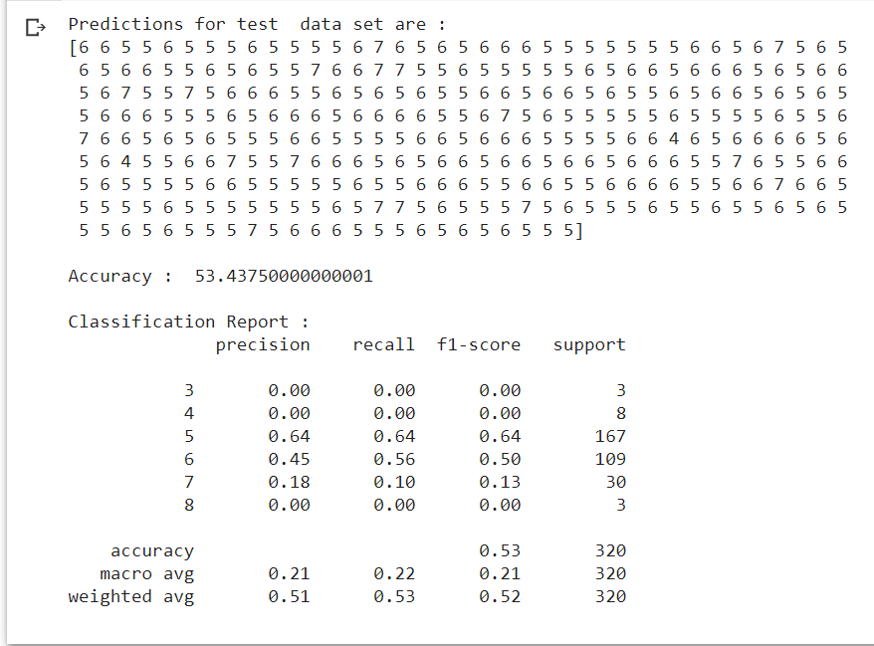
K-NEAREST NEIGHBORS - Output

Slide 13
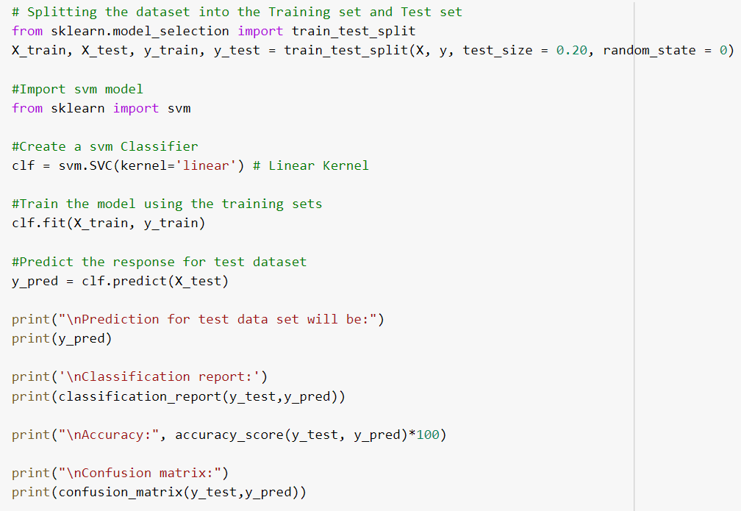
SUPPORT VECTOR MACHINE - Code

Slide 14
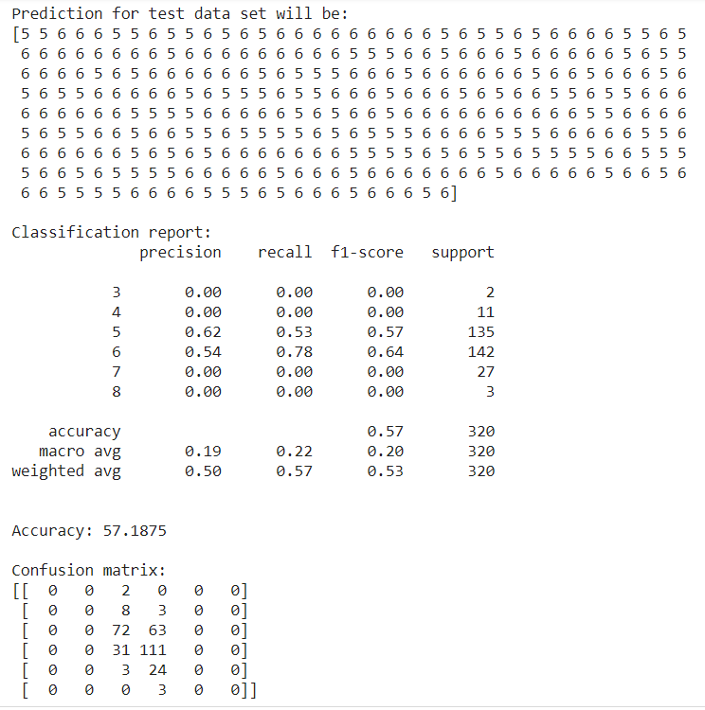
SUPPORT VECTOR MACHINE - Output

Slide 15
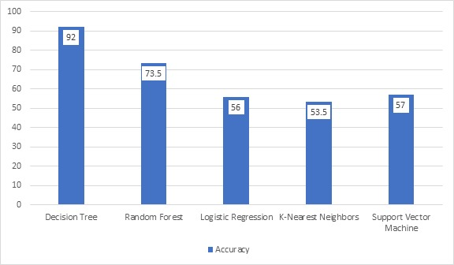
COMPARATIVE ANALYSIS OF ACCURACIES

Slide 16
INFERENCE
S.No. | Algorithm used | Accuracy (in %)
1 | Decision Tree | 91.5625 %
2 | Random Forest | 73.4375 %
3 | Logistic Regression | 55.9027 %
4 | K-Nearest Neighbors | 53.4375 %
5 | Support Vector Machine | 57.1875 %
The accuracy is highest for Decision Tree algorithm with 91.56% and is best to classify the given data set.

Slide 17
THANK YOU

